Slide 1

Chapter 5: Overview of Software Modeling and Design Method

Slide 2
Contents
1. COMET USE CASE–BASED SOFTWARE LIFE CYCLE
2. COMPARISON OF THE COMET LIFE CYCLE WITH OTHER SOFTWARE PROCESSES
3. REQUIREMENTS, ANALYSIS, AND DESIGN MODELING
4. DESIGNING SOFTWARE ARCHITECTURES

Slide 3
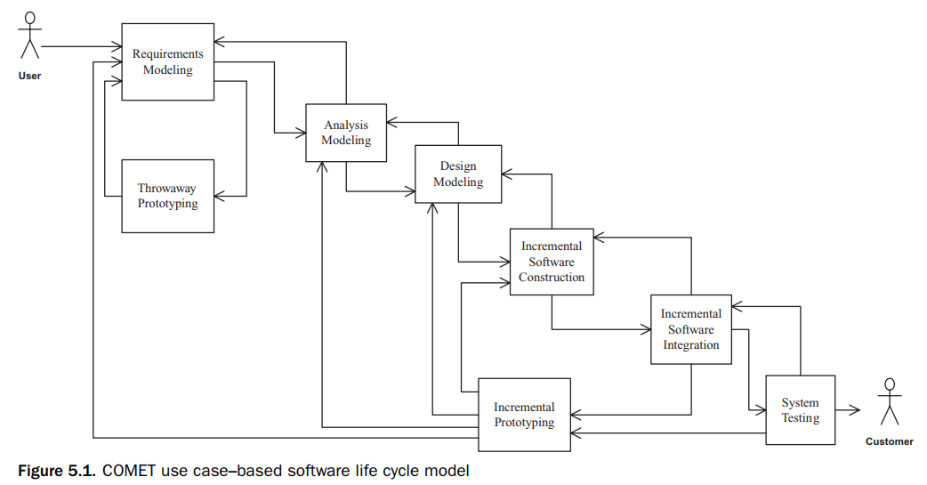
1. Comet use case–based software life cycle
Software modeling and design method described in this course is COMET (Collaborative Object Modeling and Architectural Design Method), which uses the UML notation
The COMET use case–based software life cycle model is a highly iterative software development process based around the use case concept.

Slide 4
1. Comet use case–based software life cycle
In the requirements modeling phase, a requirements model is developed in which the functional requirements of the system are described in terms of actors and use cases (use case diagram). A narrative description of each use case is developed.
In the analysis modeling phase: the use case is realized to describe the objects that participate in the use case and their interactions
In the design modeling phase: the software architecture is developed, describing components and their interfaces

Slide 5
1. Comet use case–based software life cycle
In the analysis modeling phase:
static and dynamic models of the system are developed.
The static model defines the structural relationships among problem domain classes
In the design modeling phase:
the software architecture of the system is designed, in which the analysis model is mapped to an operational environment.
Subsystem structuring criteria are provided to structure the system into subsystems

Slide 6
1. Comet use case–based software life cycle
Incremental software construction: After completion of the software architectural design, an incremental software construction approach is taken (subset of the system to be constructed for each increment)
Incremental software integration: During incremental software integration, the integration testing of each software increment is performed
If significant problems are detected in the software increment, iteration through the requirements modeling, analysis modeling, and design modeling phases might be necessary
System testing: System testing includes the functional testing of the system

Slide 7
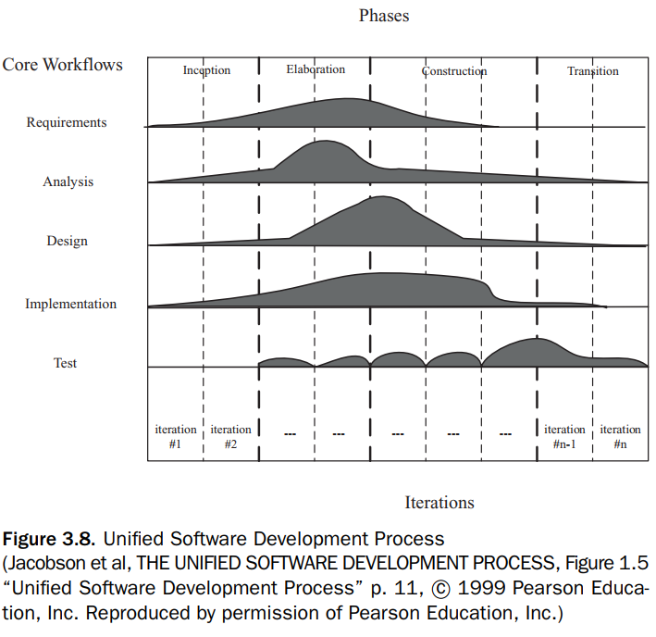
2. Comparison of the comet life cycle with other software processes
Each phase of the COMET life cycle corresponds to a workflow of the USDP (RUP) including requirements, analysis, design, implementation, and test workflows.

Slide 8
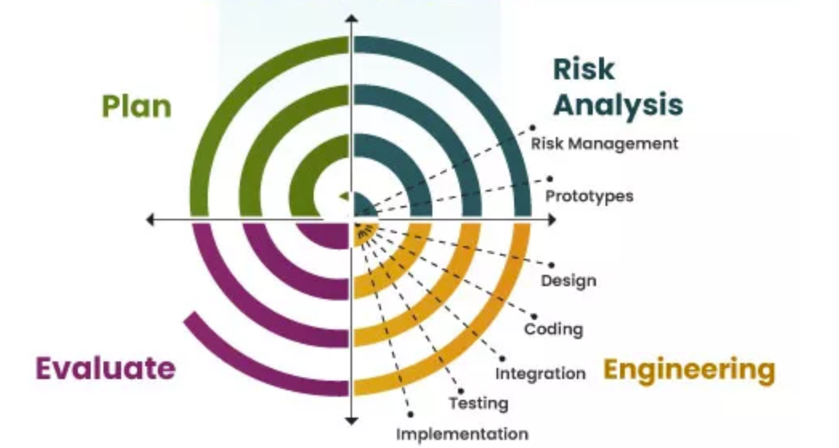
2. Comparison of the comet life cycle with other software processes
The COMET method can also be used with the spiral model, During the project planning for a given cycle of the spiral model, the project manager decides what specific technical activity should be performed in the third quadrant, which is the product development quadrant. The selected technical activity, such as requirements modeling, analysis modeling, or design modeling, is then performed in the third quadrant.

Slide 9
3. Activities in Requirements, analysis, and design modeling - Requirement
The UML notation supports requirements, analysis, and design concepts.
In the requirements model, the system is considered as a black box. The use case model is developed.
Use case modeling. Define actors and black box use cases. The functional requirements of the system are described in terms of use cases and actors
Addressing nonfunctional requirements is also important at the requirements phase.

Slide 10
3. Activities in Requirements, analysis, and design modeling - Analysis
In the analysis model, the emphasis is on understanding the problem; hence, the emphasis is on identifying the problem domain objects and the information passed between them.
As the analysis of the problem domain is considered. The activities in this model are as follows:
Static modeling
Object structuring
Dynamic interaction modeling
Dynamic state machine modeling
Activities in Analysis Modeling are presented in chapters 7,8,9,10,11

Slide 11
3. Activities in Requirements, analysis, and design modeling - Design
In the design model, the solution domain is considered. During this phase, the analysis model is mapped to a concurrent design model. Activities:
Integrate the object communication model.
Make decisions about subsystem structure and interfaces.
Make decisions about what software architectural and design patterns to use in the software architecture.
Make decisions about class interfaces, in particular for sequential software architectures.
Make decisions about how to structure the distributed application into distributed subsystems
Make decisions about the characteristics of objects, particularly whether they are active or passive.
Make decisions about the characteristics of messages, particularly whether they are asynchronous or synchronous
Activities in Design Modeling are presented in the chapters 12 to 18

Slide 12
4. Designing software architecture
During software design modeling, design decisions are made relating to the characteristics of the software architecture.
Object-Oriented Software Architectures.
Client/Server Software Architectures.
Service-Oriented Architectures.
Distributed Component-Based Software Architectures.
Real-Time Software Architectures.
Software Product Line Architectures.

